Slide 1


Whitehatch Newsletter November 2020
COVID-19
We have a good stock of PPE. We are now in the November lockdown, which we are off course taking seriously.
Testing
Weekly testing remains the norm for us all here. We continue to have no resident or staff suffering with COVID-19.
Visits / Overnight Stays
After Wednesday 4/11/20 we will be in full lockdown. Overnight stays will not be allowed in line with the government guidance.
I am waiting for more information on this but would assume we will be as with the previous lockdown and refrain from visits until lockdown is lifted. I will off course keep you updated.
ADD IMAGE
01

Slide 2

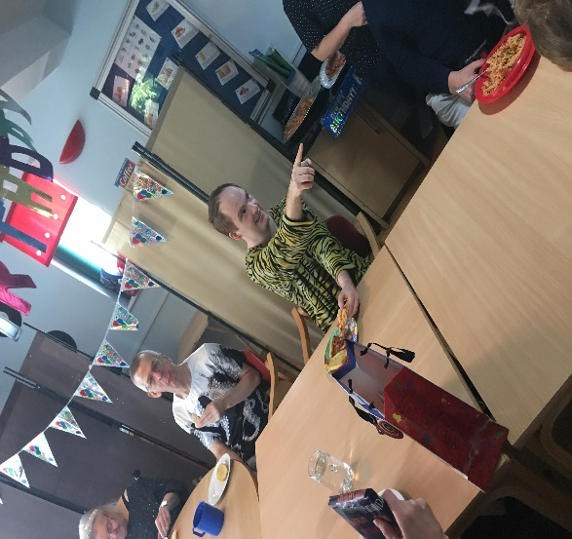
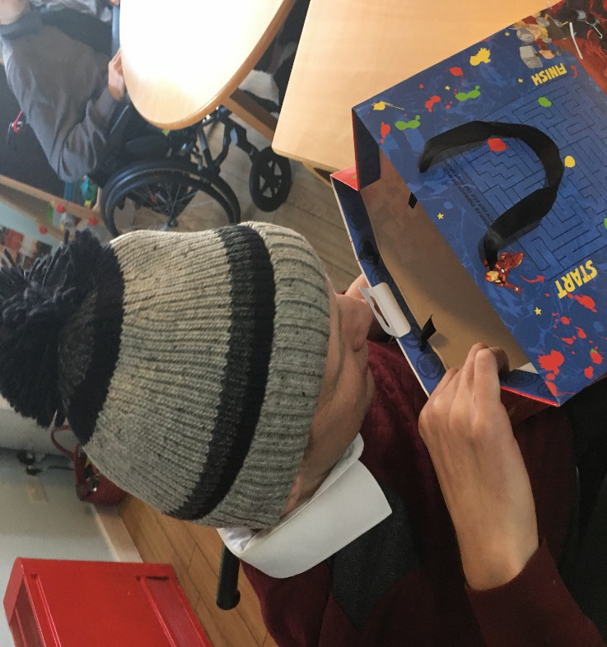
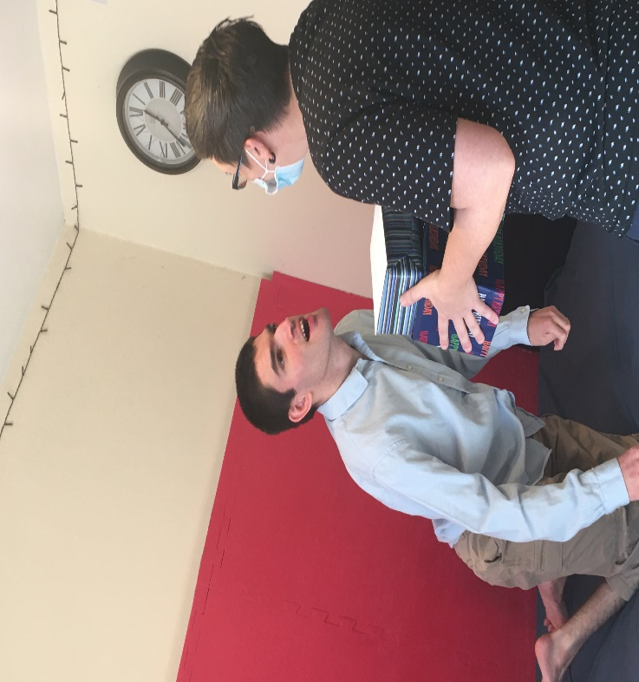
Whitehatch Newsletter November 2020
We had two birthday parties this month with pizza and music!
Happy birthday Jon & Michael!!
ADD IMAGE
Two happy chappies….
ADD IMAGE
ADD IMAGE
02

Slide 3

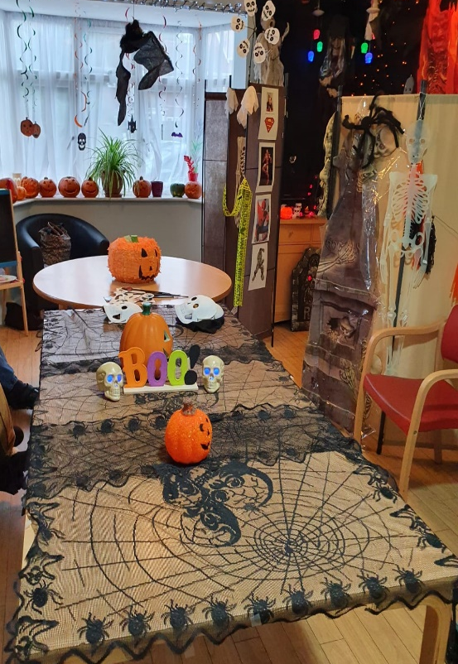
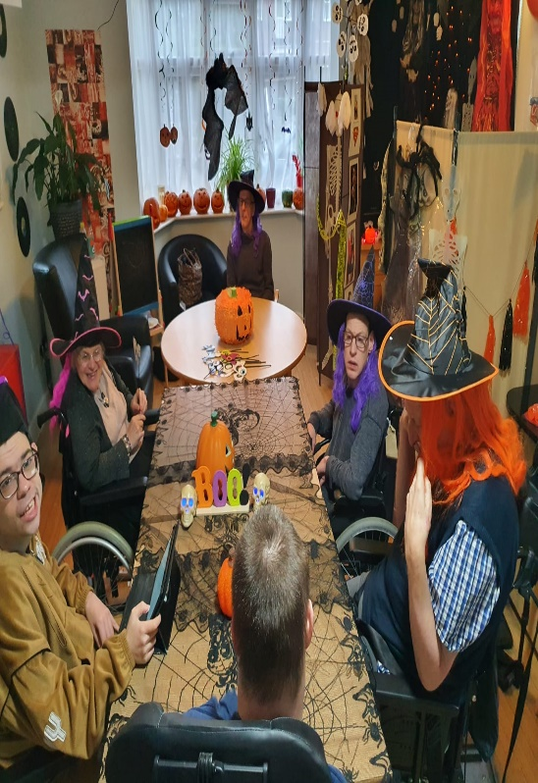
Whitehatch Newsletter November 2020
Halloween!
This spooky time of year is a firm favourite.
Stacey has been named Queen of Halloween for her stellar effort of decorating the house and organizing fun and games for all!
ADD IMAGE
ADD IMAGE
ADD IMAGE
ADD IMAGE
04

Slide 4
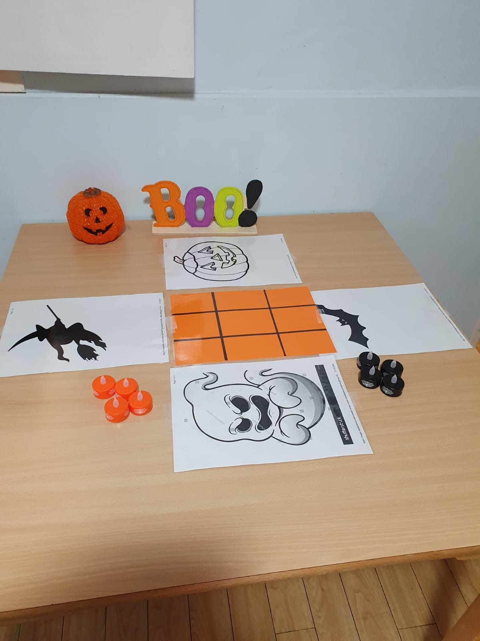
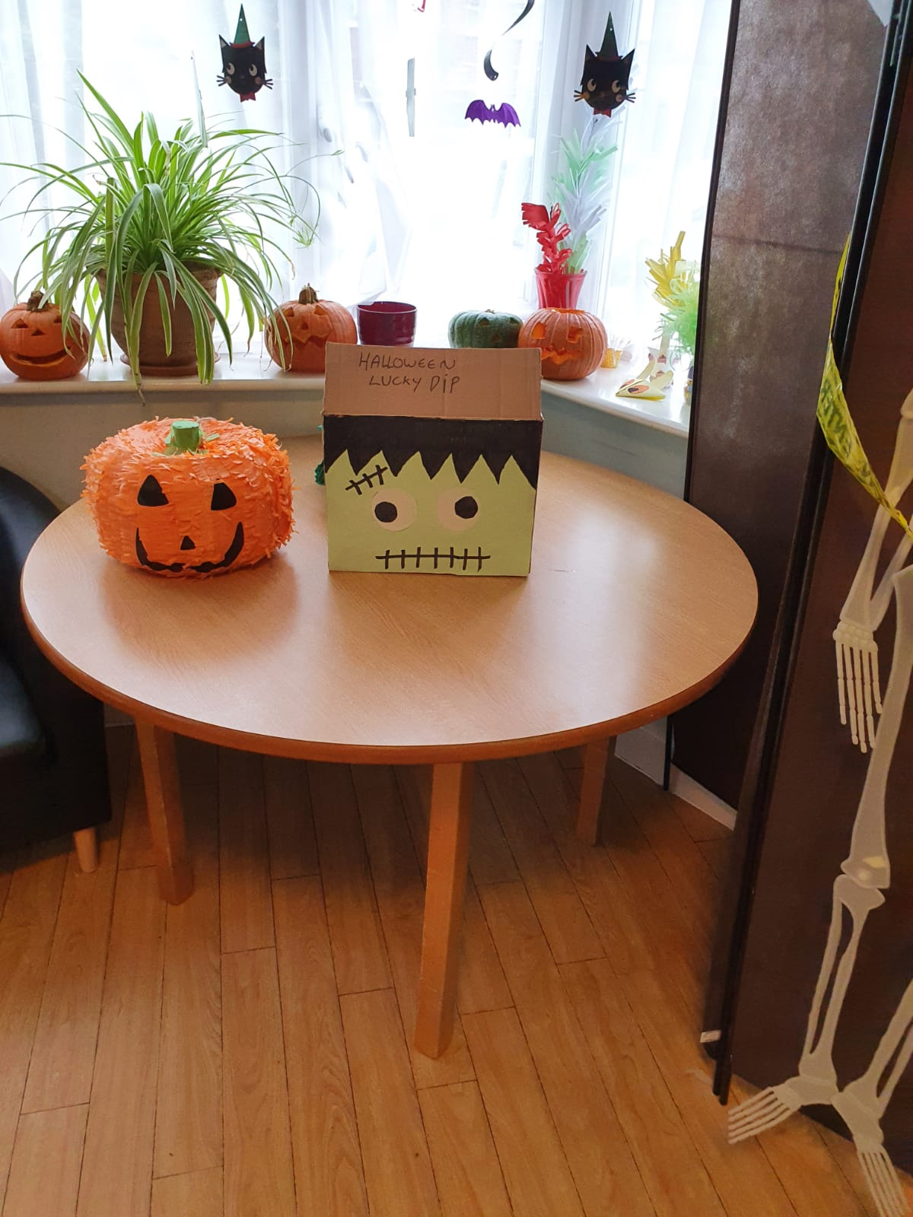
Whitehatch Newsletter November 2020
ADD IMAGE
ADD IMAGE
ADD IMAGE
ADD IMAGE
04

Slide 5
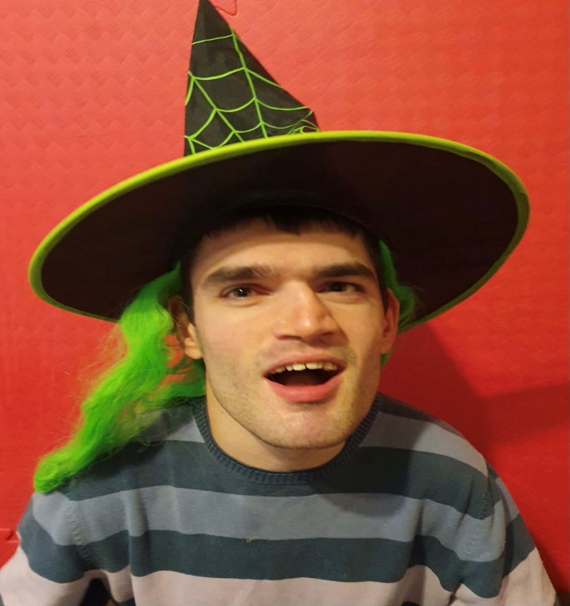
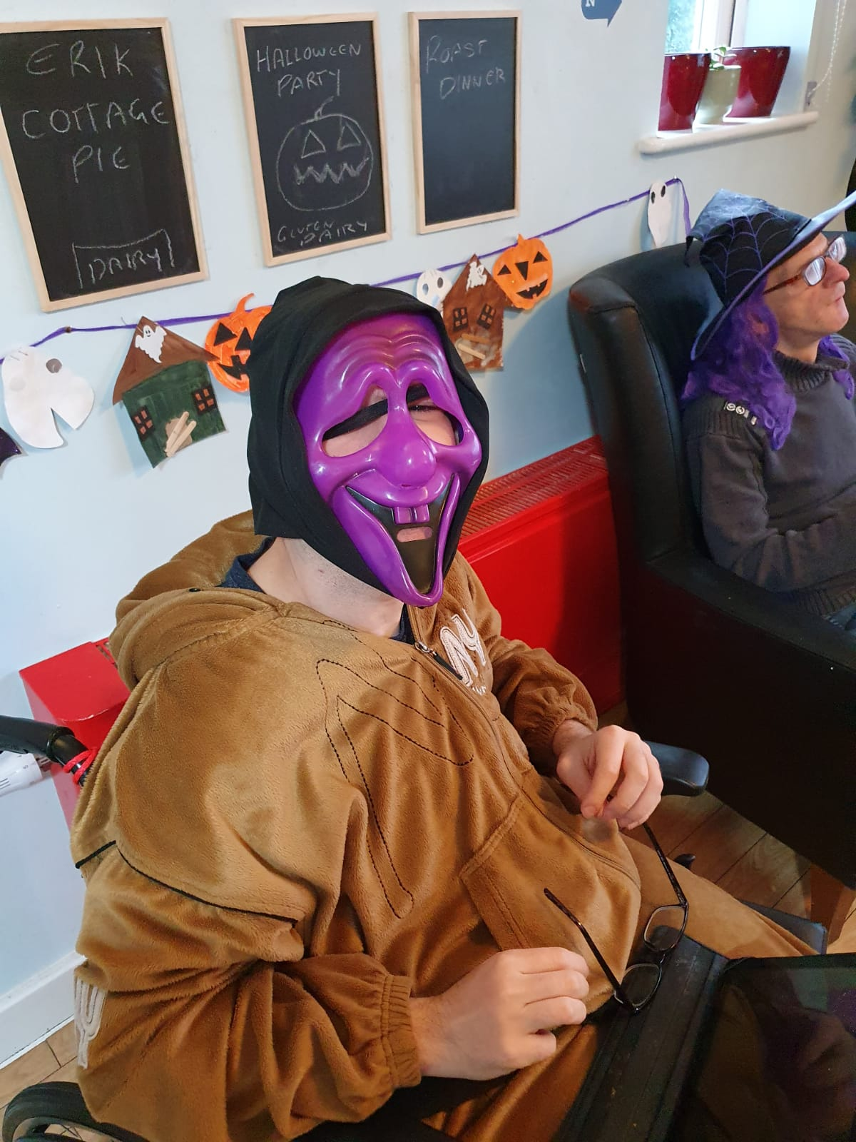
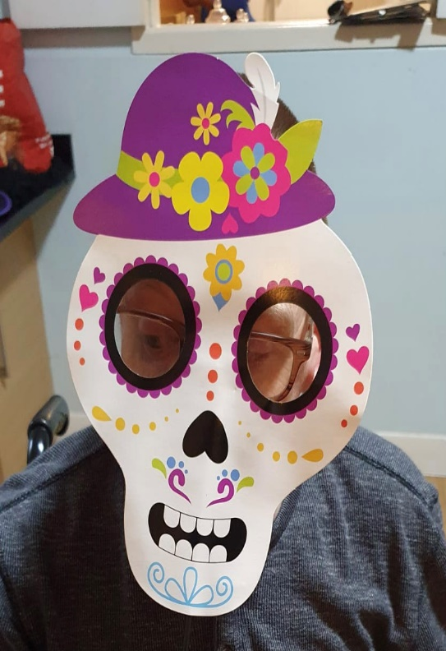
Whitehatch Newsletter November 2020
ADD IMAGE
Halloween fun and games including pumpkin carving, lucky dip, karaoke and food and drinks for all!
ADD IMAGE
ADD IMAGE
ADD IMAGE
04

Slide 6

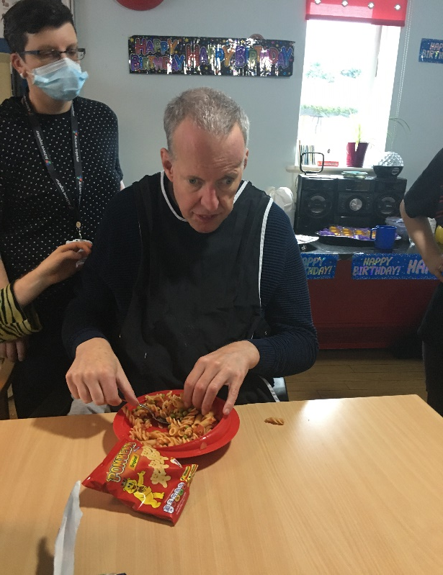
Whitehatch Newsletter November 2020
Reaching Out
After reading a report in the press about families struggling during the pandemic, Rachael felt moved to arrange a donations box to help those in need in these uncertain times and in the lead up to Christmas staff have been very generous and have been donating food items, small gifts and treats as well as toiletries to help even just a little in our small corner of the country.
ADD IMAGE
In closing, we welcome Joana to the team this month. Joana will start in post of the Service Manager on 23.11.20.
I would like to take the opportunity to thank all the staff and those we support in Whitehatch for all their efforts and continued efforts in very difficult circumstances.
As we adapt to the new lockdown we off course want to remain in touch, therefore we can reintroduce the Skype, the video calling schedules we had in place before. For those who would like this please contact me or those house directly and we can arrange.
05

