Slide 1

Oak Lodge and Hill View Newsletter
December 2020
Welcome to our December Newsletter
First of all I would like to start by reassuring everyone that again no one has any symptoms of Covid 19 on site.
We are still taking all the precautions necessary to keep your loved ones safe through these difficult times. With the new government guidelines in place we are pleased to announce that we are expecting to be receiving the rapid covid tests on site on the 18th of December for family and visitors.
Visits will have to be prearranged with either Sami or Claire and a risk assessment will take place. On the day of your visit you will be required to take a test and then if the test comes back negative you will be invited to enter the homes to visit with your loved ones.
We would like to make it very clear to family and visitors that you will still be expected to wear a mask throughout your visit. We look forward to seeing you all back and want to wish you all a very happy Christmas and New Year!
01

Slide 2

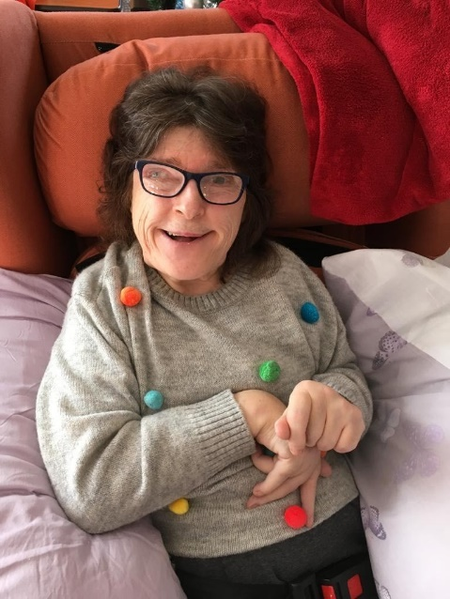
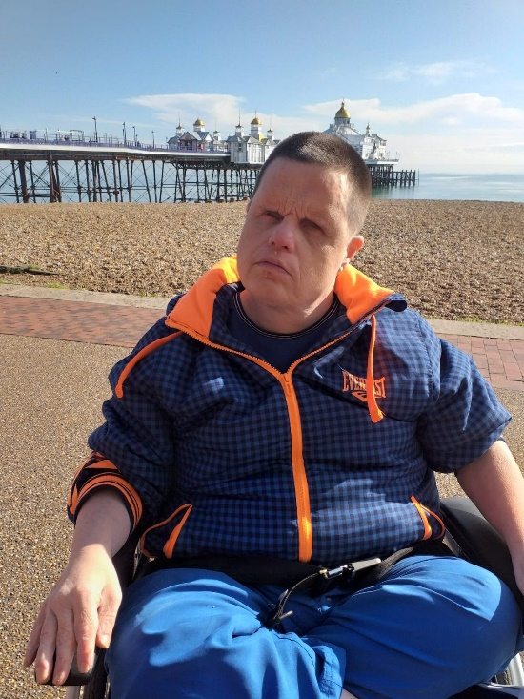
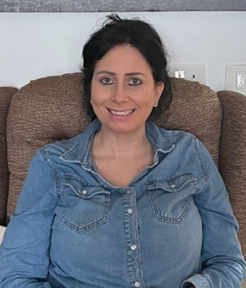
Oak Lodge and Hill View Newsletter
December 2020
First of all we would like to introduce you all to our newest member of Hill View Dawn. Dawn has been with us now since October and has fitted in nicely. Dawn is a very happy and kind lady who has a great sense of humour.
Welcome to our family Dawn ☺
ADD IMAGE
This month we are celebrating the birthday's of …
Kevin who lives in Hill View will be celebrating his birthday on the 18th December with his housemates ☺
and we also celebrate Donna a senior support worker in Oak Lodge who's birthday is on the 17th December! ☺
ADD IMAGE
ADD IMAGE
02

Slide 3

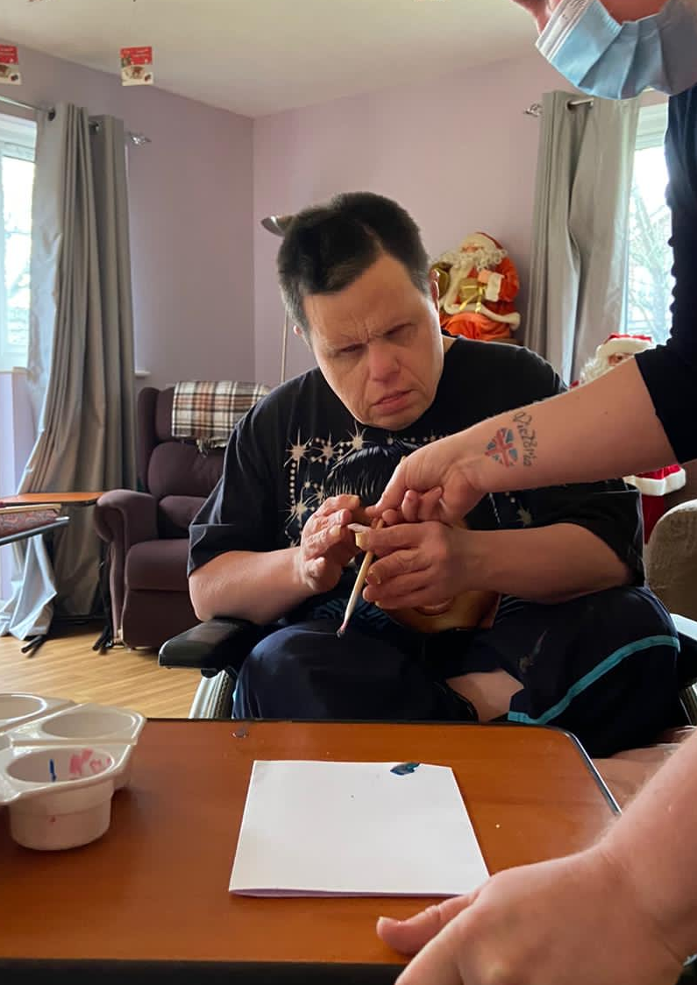
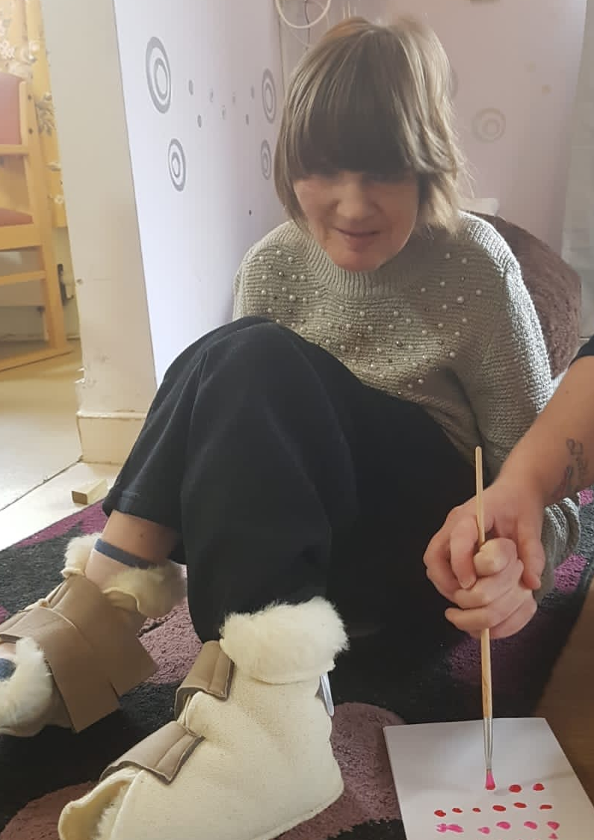
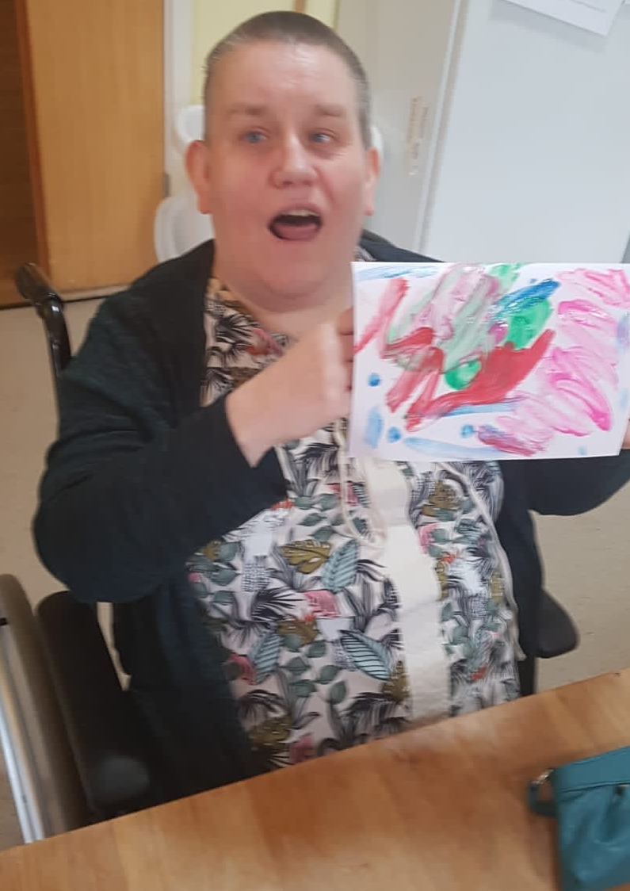
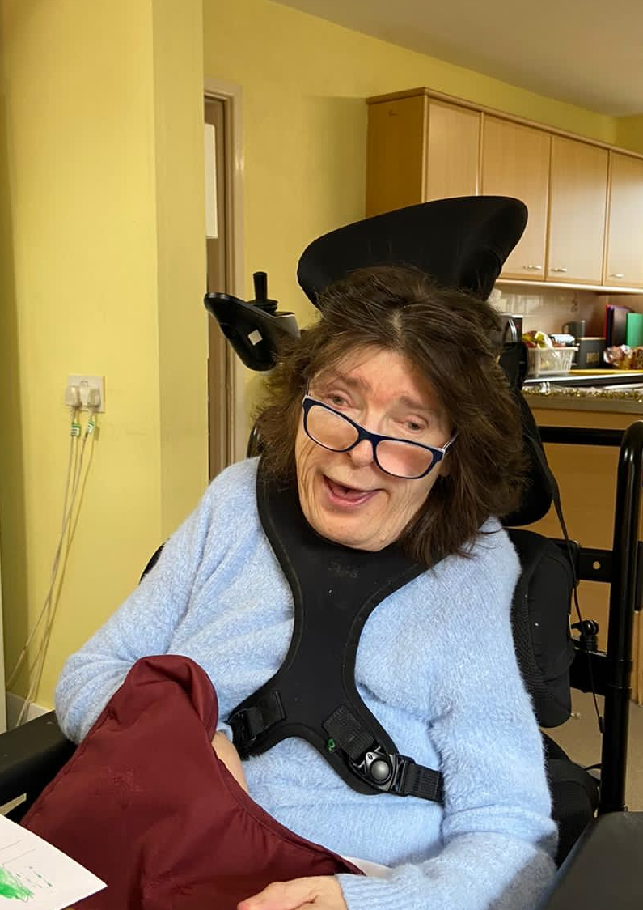
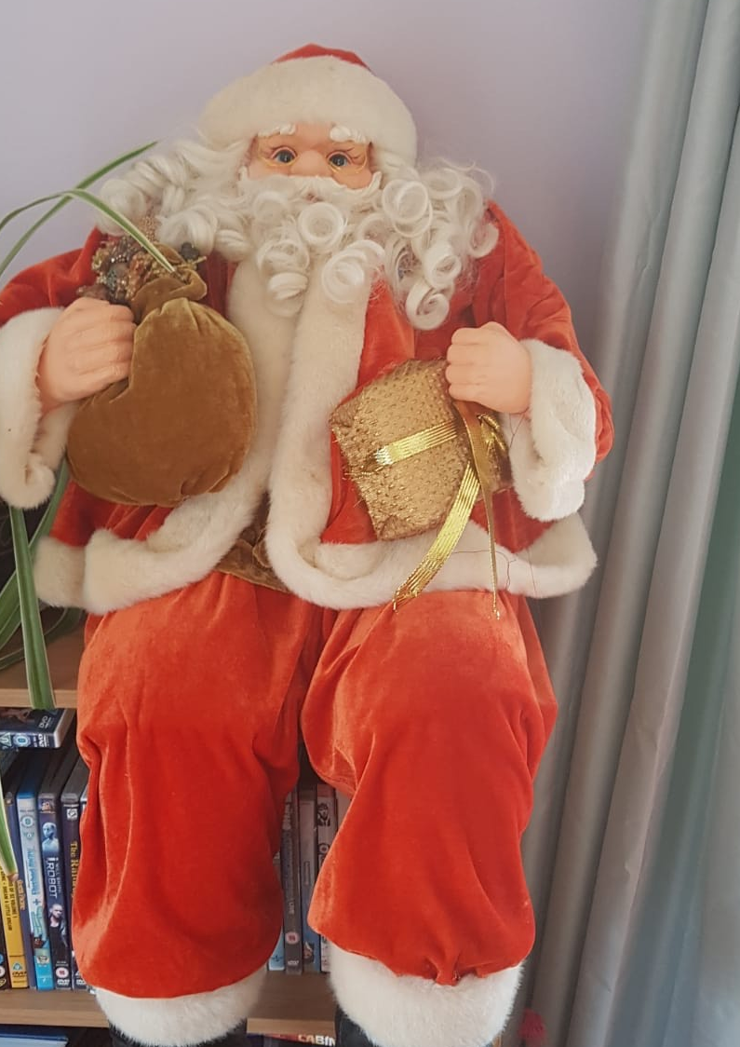
Oak Lodge and Hill View Newsletter
December 2020
This December we have had great fun making Christmas cards for our loved ones and putting up our Christmas decorations! ☺
ADD IMAGE
ADD IMAGE
ADD IMAGE
03

Slide 4
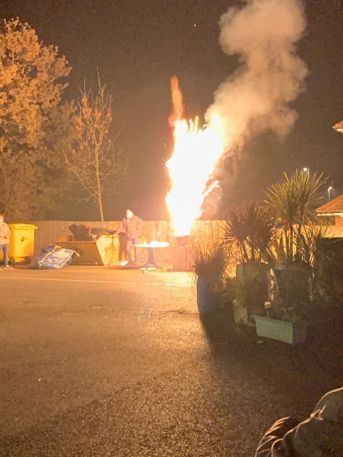


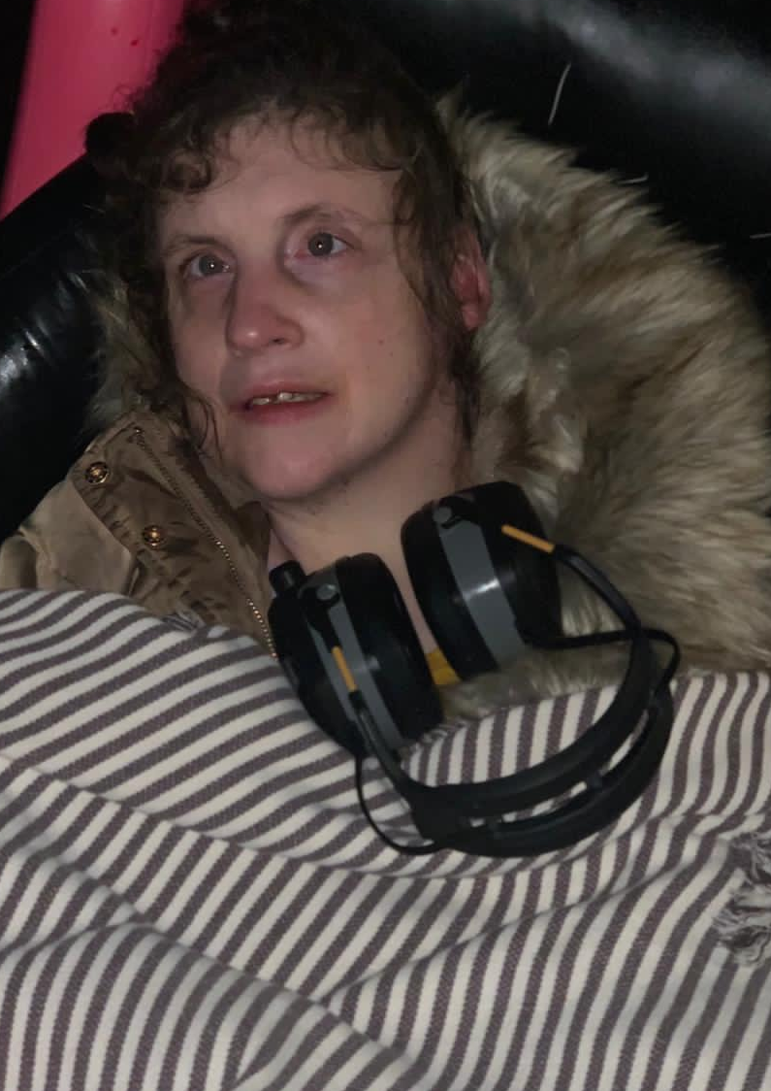
Oak Loge and Hill View Newsletter
December 2020
We had a site fireworks display for the 5th November which everyone enjoyed ☺
ADD IMAGE
ADD IMAGE
ADD IMAGE
04

Slide 5
Oak Lodge and Hill View Newsletter
December 2020
ADD IMAGE
This month we are celebrating the birthday's of …
Kevin who lives in Hill View will be celebrating his birthday on the 18th December with his housemates ☺
and we also celebrate Donna a senior support worker in Oak Lodge who's birthday is on the 17th December! ☺
ADD IMAGE
ADD IMAGE
05

Slide 6

Oak Lodge and Hill View Newsletter
December 2020
This year has not been the same for us
We have missed you being here
But we understood the virus was bad
And you stayed away because you loved us dear
We have enjoyed our video calls
And seeing you on the phones
We loved to hear your voices
It was like you were in our homes.
We want you to know
we have not been sad or mad
On the contras we have been very busy
Singing songs which made us glad
And dancing until we were dizzy.
We have enjoyed our karaoke and movie nights
And sang to our hearts content
We have enjoyed baking cooking and even bowling
And awards they did present.
All of these inside our homes
Brought in to keep us safe
We missed you lots but knew we would see you soon
We had a lot of faith
Then the government said we could go on the bus again
And we came to socially distance
We loved seeing your face and smelling your smell
And went home with a bit of resistance
Now we come close to Christmas
And we were as nervous as you
But we have heard the rapid tests are here
And look forward to seeing you soon ☺
06

