Slide 1
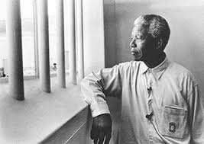
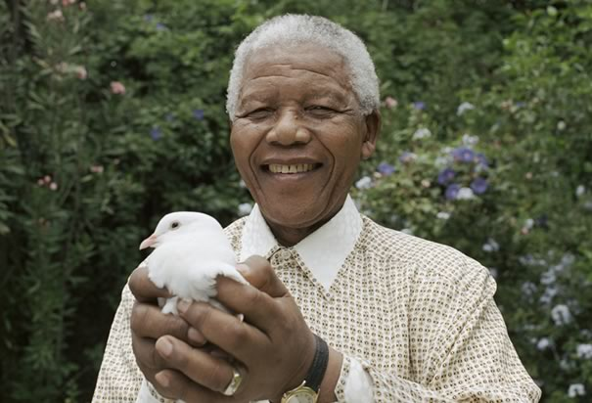
Nelson Mandela Prisoner to President
What’s all the fuss about?
Notes:
All blue underlined text is a hyperlink to something or other

Slide 2
Learning Objectives
To know what Apartheid in South Africa was,
To understand the role Nelson Mandela played in ending it and becoming President!
To have discussed if violence is ever justified
General Studies Skills:
AO1: To have understanding and knowledge of the wider world.
AO4: to communicate ideas rationally and clearly.

Slide 3
One minute challenge
Speak to the person next to you:
What do you know already about Nelson Mandela?

Slide 4
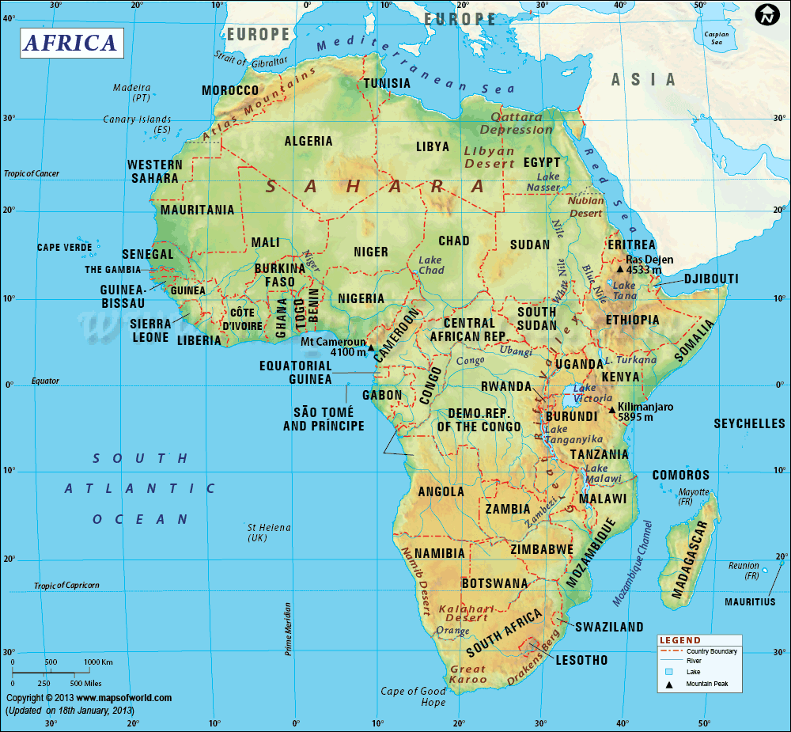
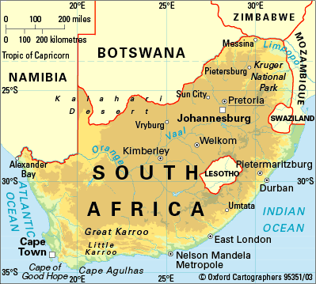
South Africa

Slide 5
What was Apartheid?
Watch the clip: (I hope it’s not patronising! ☺) and try to answer these questions
What were black people not allowed to do in S. Africa?
What organisation did Mandela create with 7 colleagues?
What was Umkhoto We Sizwe?
When did Apartheid end?
Notes:
http://youtube.com/watch?v=xNNH0G8V74o

Slide 6
What was Apartheid answers?
What were black people not allowed to do in S. Africa?
Use whites only sports facilities, cafes, toilets
What organisation did Mandela create with his friends?
The ANC (African National Congress)
What was Umkhoto We Sizwe?
‘Spear of the nation’ The armed and violent part of the African National Congress.
When did Apartheid end?
1994.

Slide 7
Apartheid
Racial Segregation
White supremacy: land ownership, resources, jobs and facilities
The Afrikaan descendants of Dutch colonists were a minority of whites ruling – often brutally – the majority of the black population.

Slide 8
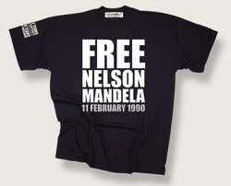
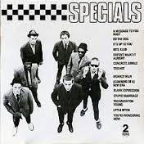
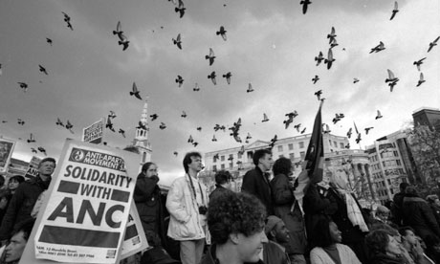
How did the world respond?
Worldwide mass protests
Economic sanctions that crippled the South African Apartheid government
Songs and festivals to raise awareness
London in the 1980s
Notes:
Image has hyperlink to the Special music video of ‘free Nelson mandela’ http://www.youtube.com/watch?v=AgcTvoWjZJU

Slide 9
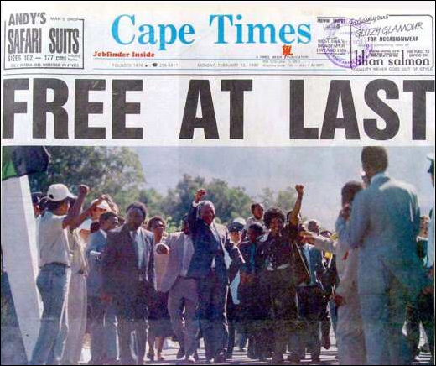
In 1990, Mandela was finally released from prison after 27 years!

Slide 10
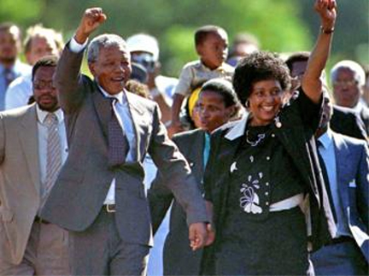
First International News conference after Mandela was freed 0:00-3:45
Watch the clip
Try to find:
One thing that interests you
One thing that surprises you
One question you would ask him.
Notes:
http://www.youtube.com/watch?v=5s8xkjG8bx4

Slide 11
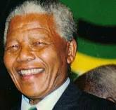
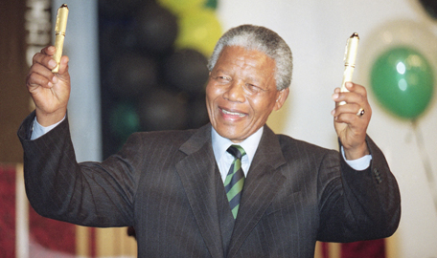
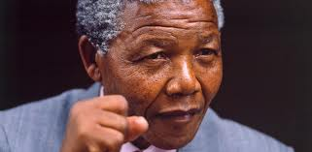
He became the first black President of South Africa in 1994! Boom!
Legend!

Slide 12
One minute Challenge
Speak to the person next to you:
One thing you learnt this morning

Slide 13
Which Extension do you want? Just click the one you do!
Free at Last:
The day Mandela was released from Jail
Film Clip
Healing a nation: truth and reconciliation
Discussion tools
‘After Apartheid?’
Is South Africa equal today?
A journey through photography
Fight with words or fists?
Is violence ever Justified?
Discussion with ethical dilemmas
Free Nelson Mandela: the Music video from 1984

Slide 14
Mandela’s first speech after being freed from Jail ‘I am against White domination. I am against Black domination.’ clip
Notes:
0:00-2:30 http://www.youtube.com/watch?v=lrALdYx9GZE

Slide 15
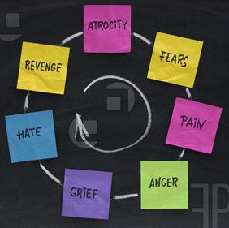
How do you end the cycle of revenge?
Truth and Reconciliation

Slide 16
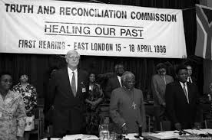
There was a lot of bitterness between black and white South Africans, so they Started the ‘Truth and Reconciliation’ Commission

Slide 17
Truth and Reconciliation
Victims and Perpetrators were brought together to speak about their experiences to each other.
It was an attempt to end the bitterness and desire for revenge between people of different races.
It was called a great success worldwide, and has tried to be repeated in many countries including Northern Ireland.

Slide 18
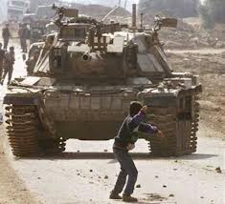
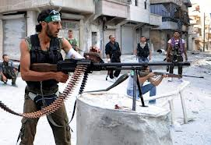
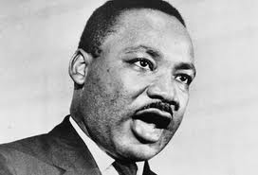
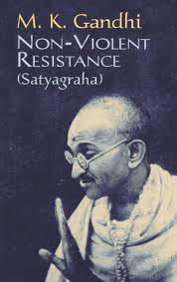
Is Violence ever justified?

Slide 19
If someone continually hits you in school/the workplace, should you hit back?
If a government is unjust?
If someone is trying to harm you/your family or friends/anyone?
Notes:
Discuss the circumstances with the group

Slide 20
Mandela resisted apartheid violently, and continued to say that armed violence was justified until he became president. Do you agree? Why/Why not?

Slide 21
Is South Africa equal today?

Slide 22
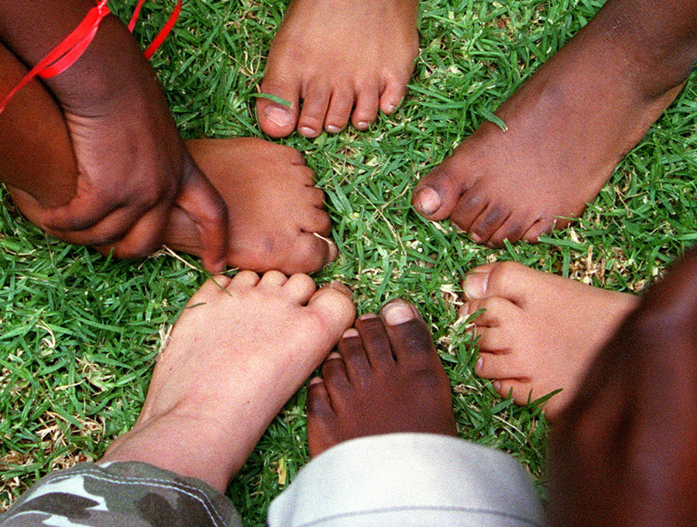
Matthew Blackburn and his friends play eeny-meeny-miny-mo to decide who is "on" in a game of "catches" at Matthew's 7th birthday party at his family's home in Johannesburg, South Africa. Matthew's social group is racially very mixed--a product of the integration that is now common in South African schools. Until Apartheid was abolished in 1994, whites and black could not attend the same schools.Because of the racial mix of Matthew’s school, most of Matthew’s friends are black. “Our kids are growing up in a totally different South Africa,” says His dad. “They’re not conscious of race like we were growing up,” he adds. The family employs a full time black maid...
Notes:
Matthew Blackburn and his friends play eeny-meeny-miny-mo to decide who is "on" in a game of "catches" at Matthew's 7th birthday party at his family's home in Johannesburg, South Africa. Matthew's social group is racially very mixed--a product of the integration that is now common in South African schools. Until Apartheid was abolished in 1994, whites and black could not attend the same schools. Matthew lives with his parents and two brothers in a predominantly white suburb of Johannesburg. Matthew’s mother, Trish, is an assistant accountant and his father, Chris, is a retauranteur currently between jobs. The Blackburn boys attend the same government school their mother attended as a child except that the school is now predominantly black rather than all-white. Because of the racial mix of the school, most of Matthew’s friends are black. “Our kids are growing up in a totally different South Africa,” says Chris Blackburn. “They’re not conscious of race like we were growing up,” he adds. The family employs a full-time black domestic servant, Eli, who helped raise the three boys from the time they were born.

Slide 23
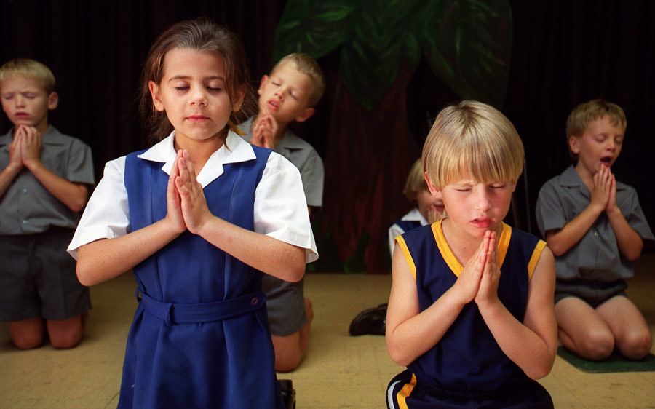
Ursula Nieuwoudt (front lefft) prays with her classmates at her primarily white school in the Hennops River area just outside of Johannesburg, South Africa. Ursula, an Afrikaner (South African of Dutch descent) lives with her parents and two sisters on a farm (not in operation). Her father, Kobus, is a town planner and consultant and her mother, Annelie, owns a topiary. The Nieuwoudts employ a black live-in cook, domestic servant and several landscapers for Annelie's business.
Notes:
Ursula Nieuwoudt (front lefft) prays with her classmates at her primarily white school in the Hennops River area just outside of Johannesburg, South Africa. Ursula, an Afrikaner (South African of Dutch descent) lives with her parents and two sisters on a farm (not in operation). Her father, Kobus, is a town planner and consultant and her mother, Annelie, owns a topiary. The Nieuwoudts employ a black live-in cook, domestic servant and several landscapers for Annelie's business. Julia

Slide 24
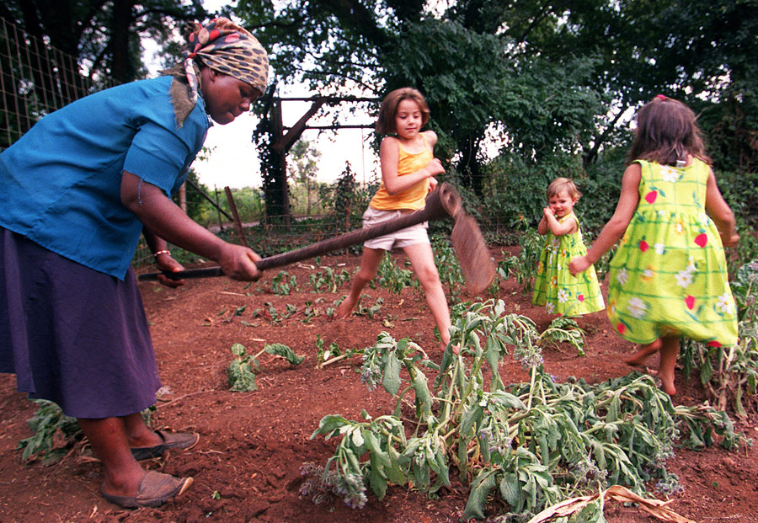
Ursula Nieuwoudt and her sisters play in the garden while one of their gardeners tills the soil at the Nieuwoudt's home in the Hennops River area just outside of Johannesburg, South Africa. Ursula, an Afrikaner (South African of Dutch descent) lives with her parents and two sisters on a farm (not in operation). "We were brought up very conservatively," says her father Kobus of the changes in South Africa since Apartheid's end. "We knew that we had to change. We never say racist things in front of our children," he adds
Notes:
Ursula Nieuwoudt and her sisters play in the garden while one of their gardeners tills the soil at the Nieuwoudt's home in the Hennops River area just outside of Johannesburg, South Africa. Ursula, an Afrikaner (South African of Dutch descent) lives with her parents and two sisters on a farm (not in operation). "We were brought up very conservatively," says her father Kobus of the changes in South Africa since Apartheid's end. "We knew that we had to change. We never say racist things in front of our children," he adds

Slide 25
First grade teacher, Johanna Mothabela, gives her students a Bible lesson at Bathabile Elementary School. Only three out of the seven Mashila children attend school because the family cannot afford the school fees. Brenda Mashila is second from right. She and her two siblings walk over 5 km to and from school every day.
Notes:
First grade teacher, Johanna Mothabela, gives her students a Bible lesson at Bathabile Elementary School. Only three out of the seven Mashila children attend school because the family cannot afford the school fees. Brenda Mashila is second from right. She and her two siblings walk over 5 km to and from school every day.

Slide 26
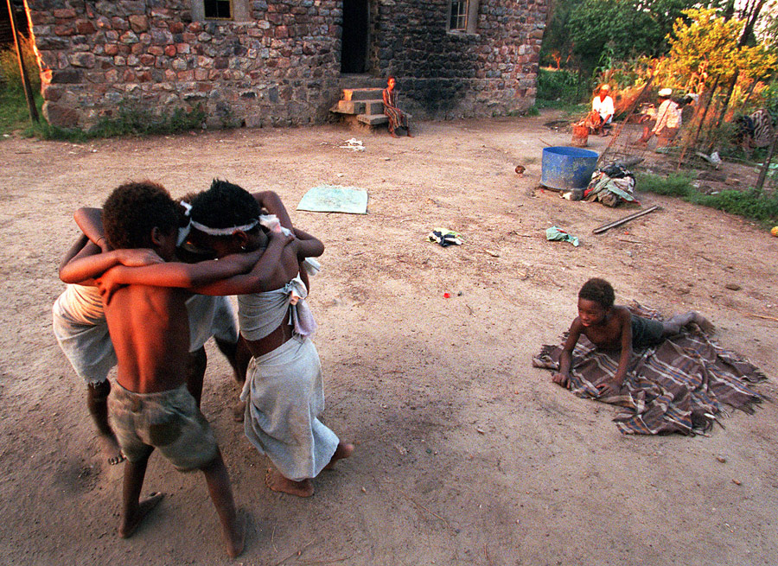
Brenda, her siblings and cousins dance outside their home in a rural area outside of Johannesburg, South Africa. The children made matching outfits out of some material they found in the trash and decided a performance should follow. With no television and few toys, the Mashila children frequently make up games to entertain themselves using whatever props they find.
Notes:
Brenda, her siblings and cousins dance outside their home in a rural area outside of Johannesburg, South Africa. The children made matching outfits out of some material they found in the trash and decided a performance should follow. With no television and few toys, the Mashila children frequently make up games to entertain themselves using whatever props they find

Slide 27
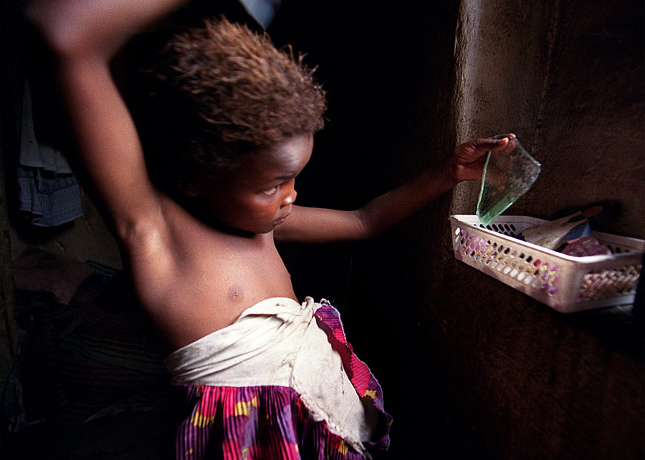
Brenda - who lives in a mostly black populated township around Johannesburg- brushes her hair before church. The small piece of mirror in her hand is a much treasured item which the children take turns using when grooming themselves
Notes:
Brenda brushes her hair before church. The small piece of mirror in her hand is a much treasured item which the children take turns using when grooming themselves

Slide 28
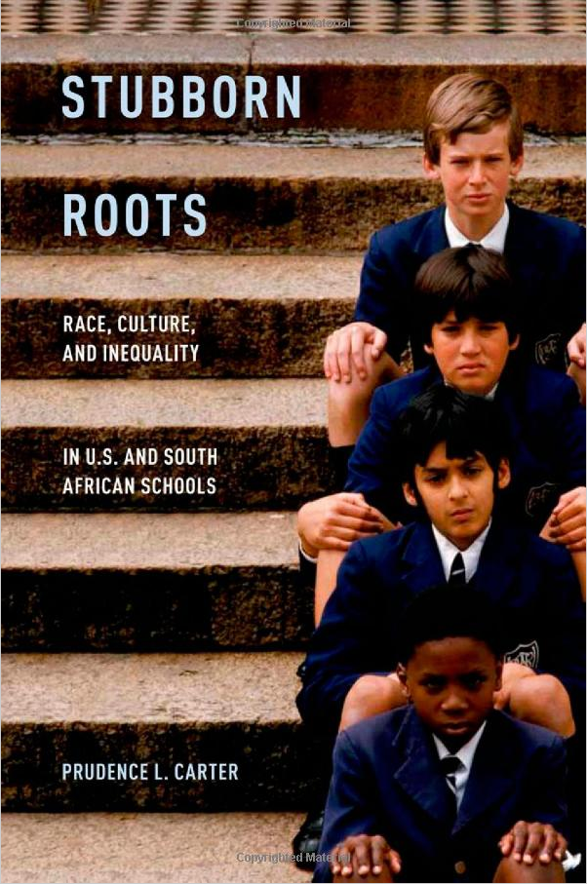
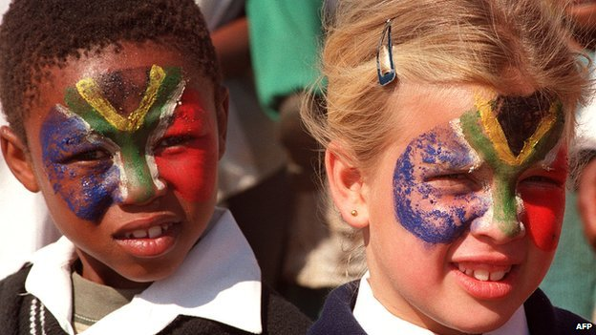
Although equality has improved, overall, there is still generally a divide: white people tend to be richer than black people, or indeed people of any other race.

